Slide 1
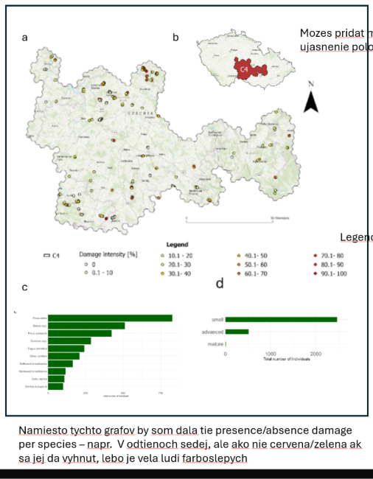
Patterns, agents and drivers of damage in early tree regeneration
following the post-2017 disturbance wave in Central Europe

